Slide 1
Lecture 2
Key concepts

Slide 2
KEY concepts
Title: Presentation
Subtitle field
Information externalities
Network externalities and two-sided platforms
Digitization and new business models
Costly to produce, costless to reproduce
Public good
Digital commons
Experience good
Complementarity between data and algorithms

Slide 3
externalities
Title: Presentation
Subtitle field
Individual action creates an economic effect on others that is not directly captured by a market mechanism
Two types:
Information externalities
Network externalities

Slide 4
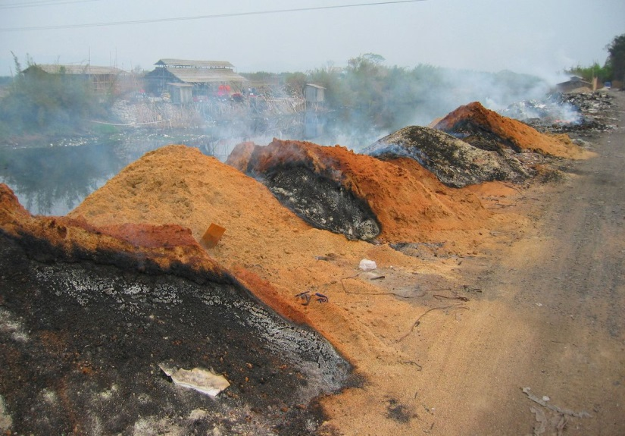
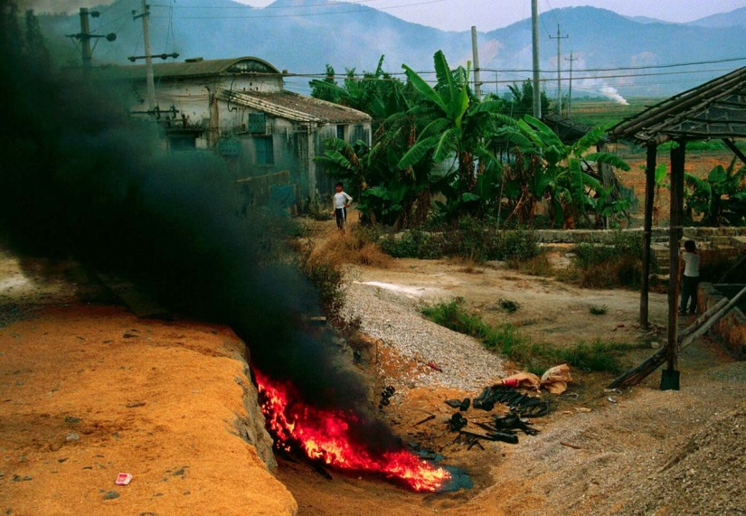
Negative externalities: pollution
Title: Presentation
Subtitle field
Mercury, lead, cadmium, …
Neurotoxic, carcinogenic, radioactive, toxic waste

Slide 5
Negative externalities: pollution (cont.)
Title: Presentation
Subtitle field
Environmental
14 billion smartphones in 2020
An iPhone X emits 79 kg of greenhouse gases from design to recycling.
Solicitation of rare metals (tantale, niobum, palladium)
Rare earths (scandium, yttrium, lanthanides) are extremely energy-intensive to extract.
Server power and water consumption
Cost to extract does not increase linearly
AI’s growing thirst
Planned obsolescence
Impact on Society and on human mind: see next lectures

Slide 6
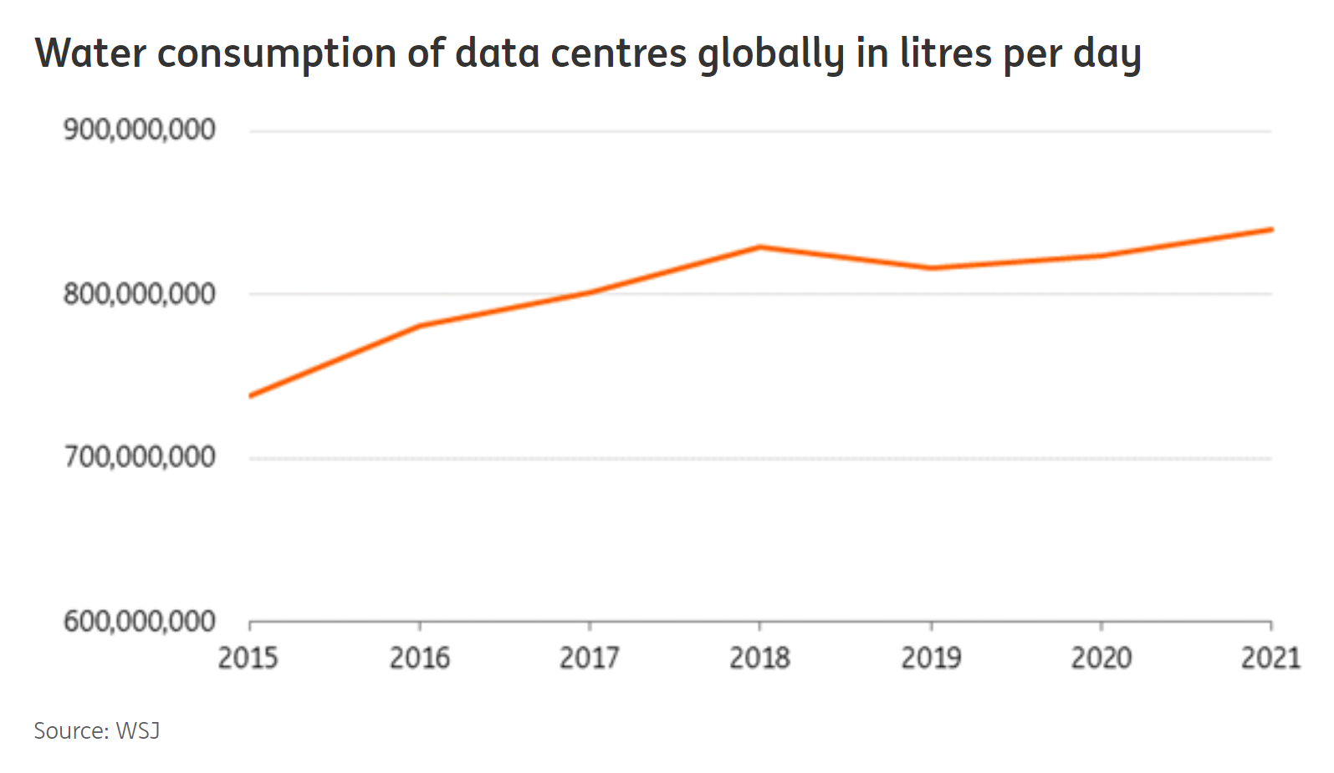
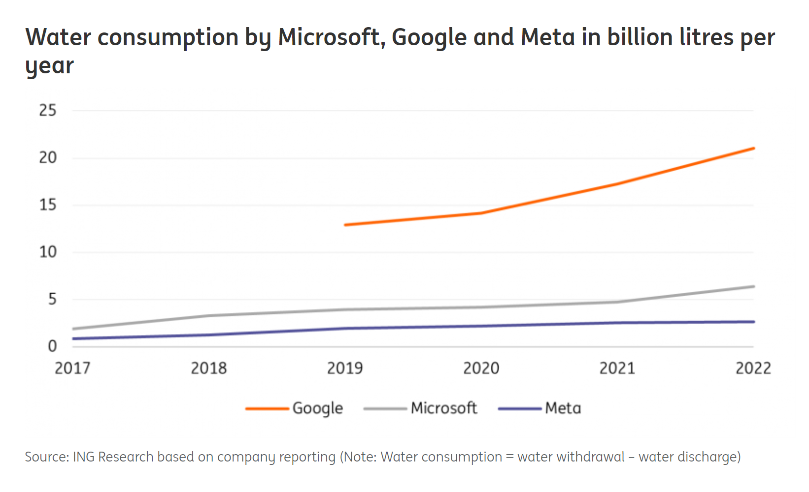
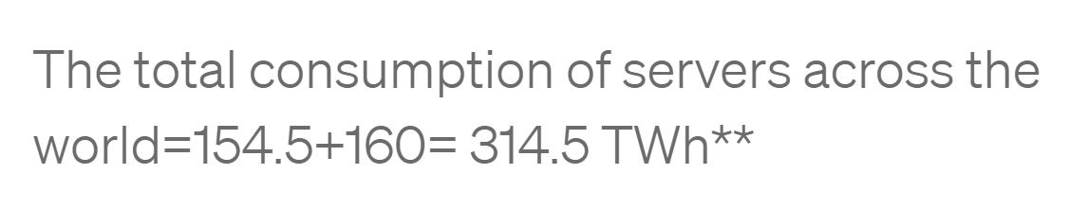
Title: Presentation
Subtitle field
Right behind India

Slide 7
externalities
Title: Presentation
Subtitle field
Two types of externalities matter in the digital economy:
Information externalities
Network externalities

Slide 8
Information externalities
Title: Presentation
Subtitle field
Example: online reviews on Amazon.com
The review benefits all potential consumers but the reviewer is not paid
Huge effect on income and profits (see lecture on e-commerce)
External effects not taken into account by markets
Can be positive or negative
Spam, online harassment, …

Slide 9
network externalities
Title: Presentation
Subtitle field
Example: the value of a software increases with the number of users (Word, Windows, etc.)
Direct network externalities
Indirect network externalites and 2-sided platforms = a demand economy of scale that crosses heterogeneous markets.
Examples include:
card-holders & merchants that accept the same credit card
content consumers & creators (e.g. PDF, MP3 streaming, video)
Online dating site
Key message: what happens on one-side has an effect on the other side

Slide 10
Economics of platforms
Title: Presentation
Subtitle field
The platform owner acts as a gatekeeper and maximizes the economic value of the different types of externalities
Examples:
Meetic: men/women
Crowfunding/P2P lending: lenders/borrowers
Payment instruments: Consumers/merchants
Google/Facebook : 3 sides - consumers, advertizers, producers
Video games: Game console, developers, players

Slide 11
New pricing strategies
Title: Presentation
Subtitle field
Goal : Prices that exploit externalities
Controlling access to scarce platform resources
Nightclub effect
Free for women
Men pay two part tariffs
Commission on both sides (Uber, AirBnb, etc.)

Slide 12
Effect of digitization on New business models
Title: Presentation
Subtitle field
Less reliance on physical products, better knowledge of customers → customized services
Consumer as a buyer of physical products → consumer engaged in a long term relationship
Examples : leasing, personalized streaming services (before: DVD and videogame purchases)

Slide 13
Sunk costs
Title: Presentation
Subtitle field
Less reliance on physical products, better knowledge of customers → customized services
Consumer as a buyer of physical products → consumer engaged in a long term relationship
Examples : leasing, personalized streaming services (before: DVD and videogame purchases)

Slide 14
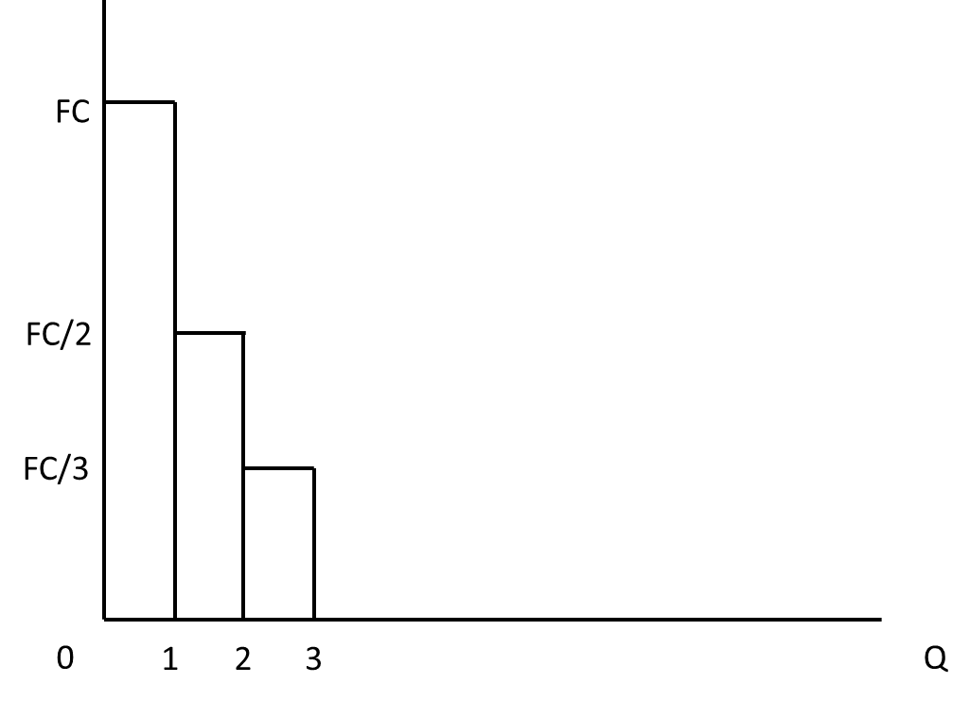
Cost structure
Title: Presentation
Subtitle field
Costly to produce, Costless to reproduce: marginal cost (MC) = 0
FC = fixed cost
Total cost = fixed cost + variable cost
What is the average cost to produce 1, 2, 3, … units?

Slide 15
Consumer and producer surplus
Title: Presentation
Subtitle field
Consumer surplus
is the difference between the price paid and the higher price that consumers would have been willing to pay for the product.
Producer surplus
is the difference between the payment received and the minimum payment that producers would have accepted.
Total surplus = consumer surplus + producer surplus

Slide 16
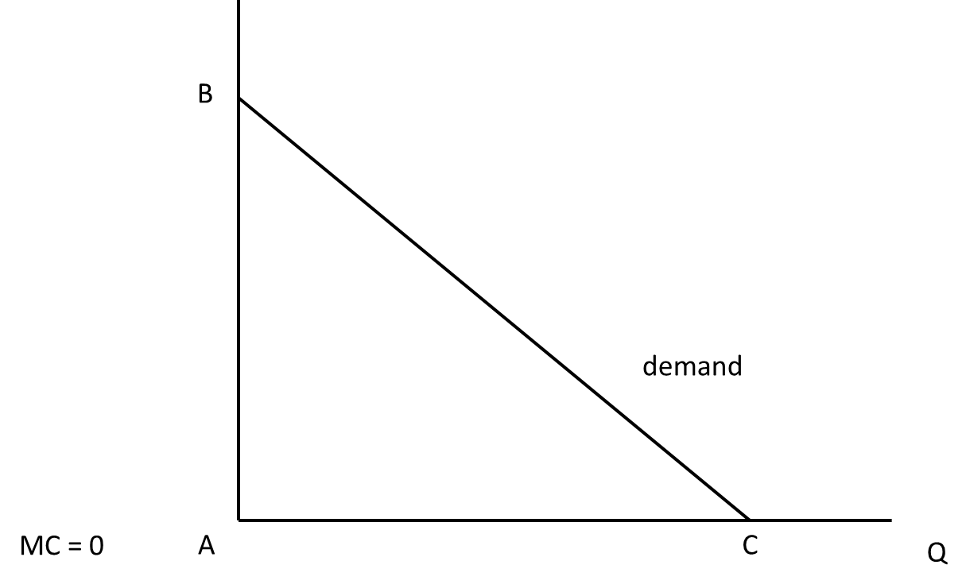
Zero marginal cost and competition
Title: Presentation
Subtitle field
In a competitive equilibrium, firms do not earn profits and price = MC
Consumer surplus?
Producer surplus?

Slide 17
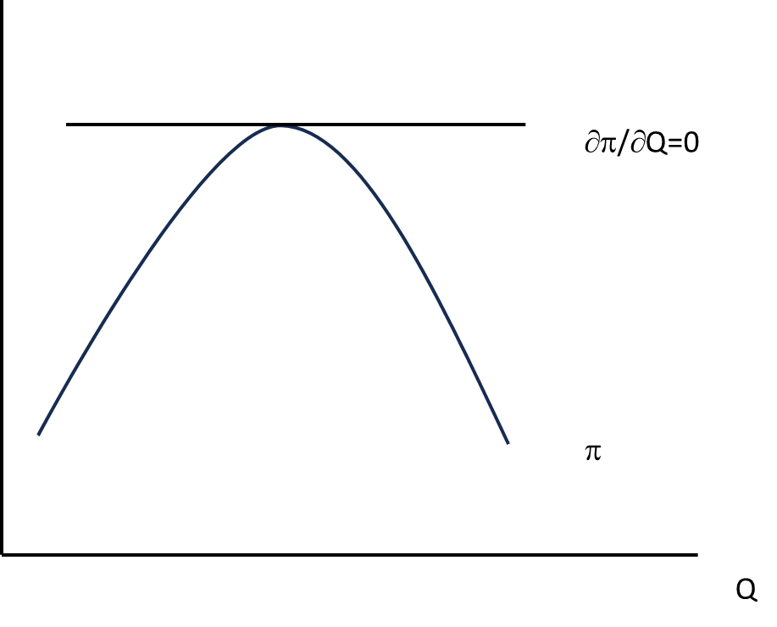
Monopoly pricing
Title: Presentation
Subtitle field
Maximize profits (π) = total revenue (TR) – total cost (TC)
Optimum: MR = MC

Slide 18
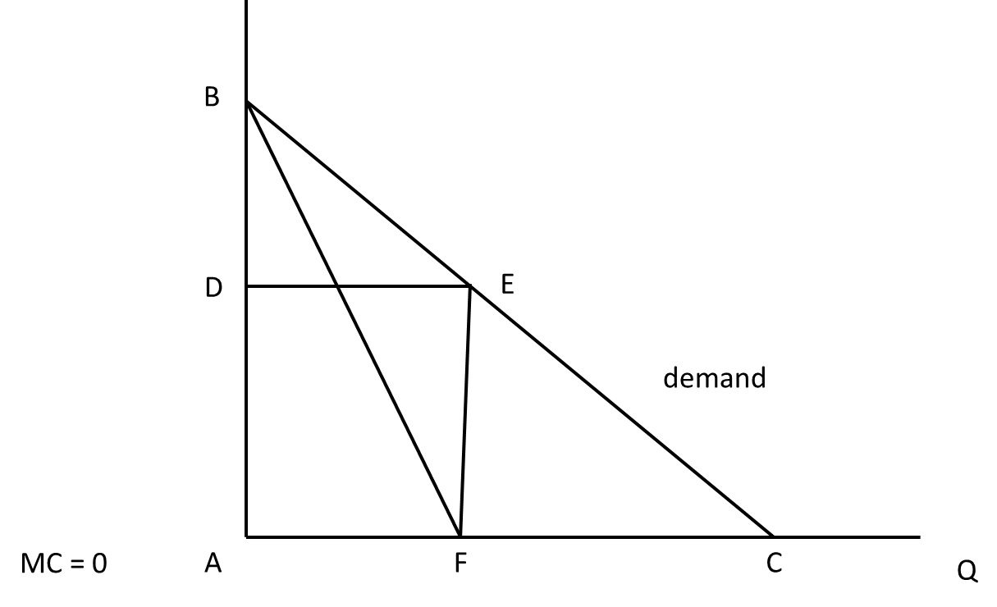
Monopoly pricing
Title: Presentation
Subtitle field
Equilbrium price?
Consumer surplus?
Producer surplus?
Deadweight loss?

Slide 19
Public goods
Title: Presentation
Subtitle field
Definition: Goods that do not get used up when consumed. In other words, one person’s consumption of a good doesn’t reduce anyone else’s potential consumption of the same good.
Examples: Ideas, television broadcasts, national defense.
Obviously, these are not physical items that get used up. Instead they are usually ideas and artistic expressions.
They are at the core of the Information Age Economy, since information is a public good.

Slide 20
Non rivalry
Title: Presentation
Subtitle field
Nonrivalry means that the amount one person consumes does not affect the amount available for others.
Rivalry allows for price competition among consumers.
If there are a limited number of luxury cars, Van Gogh paintings, stock shares, people will pay more for them.
This is called scarcity
If there is no limit to the number of goods available, no one will want to pay more than the lowest price.

Slide 21
Non Excludability
Title: Presentation
Subtitle field
Difficult to exclude people from using the good
This is a technical issue as it is always possible to exclude
Example: air, highway tolls

Slide 22
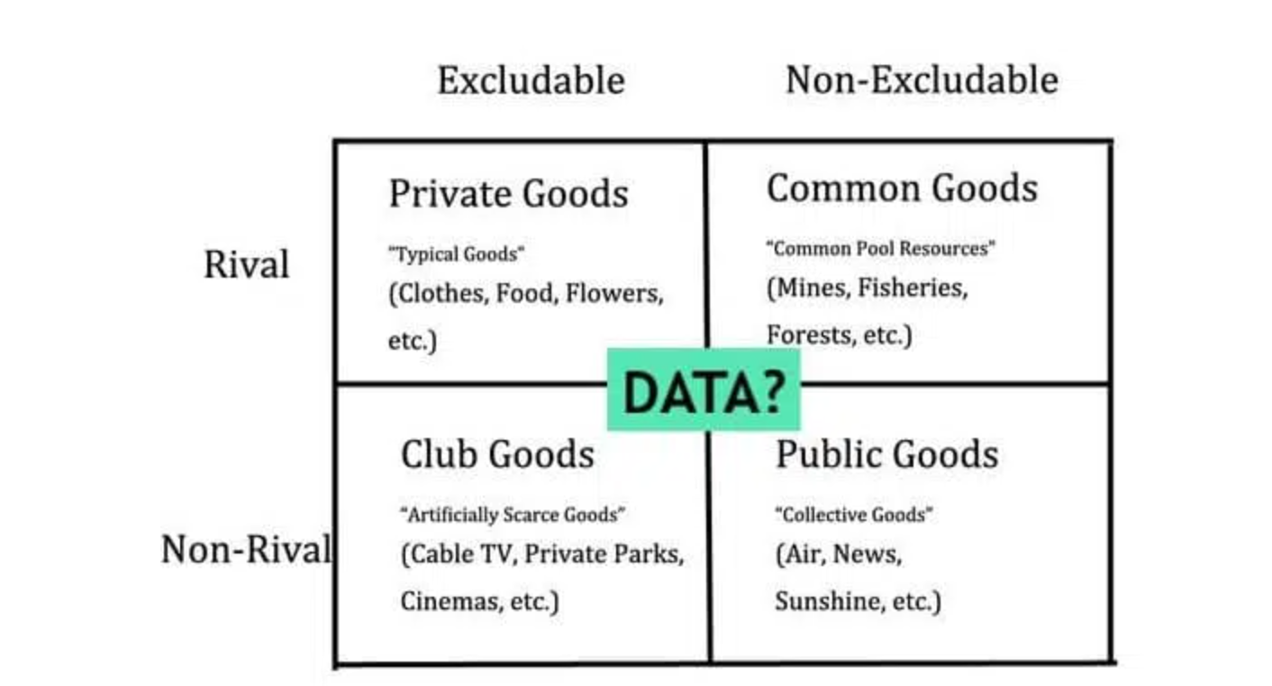
Title: Presentation
Subtitle field

Slide 23
Public goods
Title: Presentation
Subtitle field
Free riders
A firm cannot capture all social surplus
competition drives down the price to marginal cost; zero profit
Under-production of the public good
So: in general produced by government agencies
Question : Should data be produced by governments?
Unheard of, but question is relevant

Slide 24
Commons
Title: Presentation
Subtitle field
Tragedy of the commons
Tragedy of the anti-commons

Slide 25
Experience good
Title: Presentation
Subtitle field
Part of the law of supply and demand requires that consumers can accurately assess their choices.
Information goods are experience goods.
I don’t know how much I’ll like a CD until I hear it.
Compare this to a traditional good, like a car or a chair.
This means that consumers have a hard time determining how much they’re willing to pay.
give information to customers: recommendations, try-before-purchase, freemium, F2P
Consequence: Reputation matters (see next lectures)

Slide 26
Complementarity between data and algorithms
Title: Presentation
Subtitle field
Data gives a double competitive advantage
More precise data allow firms to better target customers
More data allow AI tools to become better
Economics of scale and of scope

Slide 27
Title
Subtitle

